Slide 1


Converting PowerShell Scripts to use Graph API
Wed, Nov 17 | 17:00 – 18:00 (India Standard Time)
Livestream event
Chendrayan Venkatesan
(Speaker)
Rohit Yadav
(Moderator)
Arpita Das
(Moderator)
Microsoft Most Valuable Professional
Gold Microsoft Learn Student Ambassador
Gold Microsoft Learn Student Ambassador

Slide 2
Chendrayan Venkatesan MVP | MCTS | MCP | ITIL V3 @ChendrayanV https://about-powershell.com
Rohit Yadav
Gold Microsoft Learn Student Ambassador
@rty2423
Arpita Das
Gold Microsoft Learn Student Ambassador
@arpiiitaaa

Slide 3
PS C:\> $Agenda
Brief introduction to PowerShell
Overview of Microsoft Graph API
Microsoft PowerShell Graph Modules
Building Custom Modules (Script)
API Permissions
Demo
Building a web app using PowerShell Pode module.
Containerize the application

Slide 4
PS C:\> $Prerequisites
Azure & Microsoft account.
Permission to register application.
Permission to grant delegate/application permission to the application.
Visual Studio Code + PowerShell extension.

Slide 5
PS C:\> Introduction to PowerShell
PowerShell is a cross-platform task automation solution.
Developer: Microsoft
Stable Release: Nov 09, 2021
Implementation Language: C#
A far more than a Scripting Language.
Commands are cmdlets – Cmdlets can be compiled in any .NET language / PS script.
Monad Manifesto – the Origin of Windows PowerShell
PowerShell Documentation
Find and install required modules. (PowerShell Gallery)
Release of version 7.2.0
All you need is this.

Slide 6
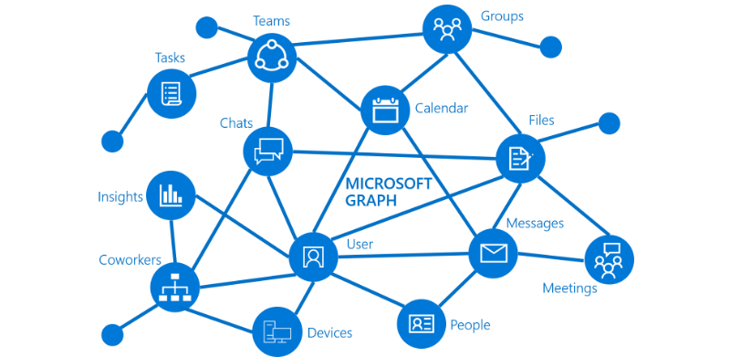
PS C:\> $Microsoft_Graph_API
Unified program model for data & intelligence in M365.
A single endpoint to access rich, people-centric data & insights in MS cloud.
Microsoft Graph Connectors
Incoming Request Direction & Deliver data to external
Data sources – Box, Google Drive etc.
Microsoft Graph Data Connect
Set of tools to streamline secure and build scalable solution.
Allows to make intelligent applications.
Use the Microsoft Graph API.

Slide 7
PS C:\> What can I do with MS Graph API?
Integrate intelligence with your application.
Workflows, automations, orchestrations.
Web Apps.
Work with
Calendars/ Events
Important Emails
SharePoint lists

Slide 8
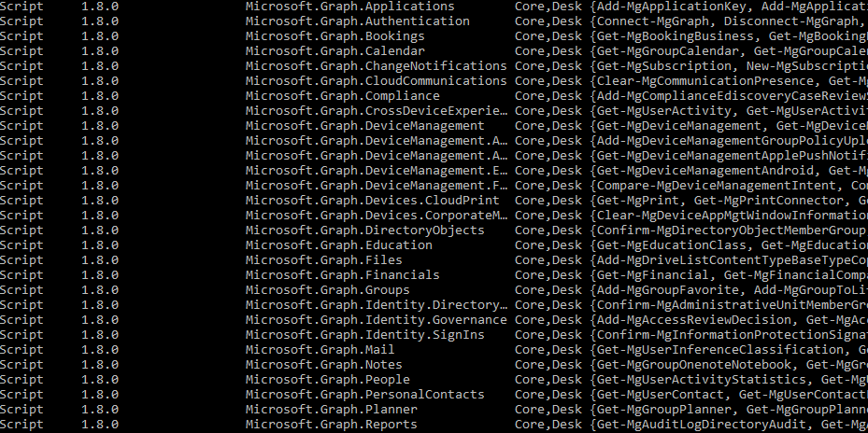
PS C:\> $PowerShell_Module
Graph PowerShell SDK.
Navigating the Microsoft Graph PowerShell SDK.
Use app-only authentication with the Microsoft Graph PowerShell SDK.

Slide 9
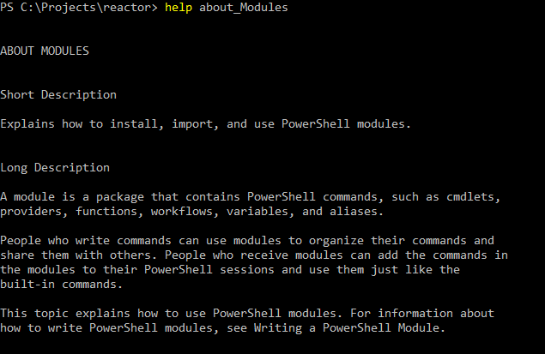
PS C:\> $Custom_Module
A package that contains PowerShell members
Cmdlets, Providers, Functions, Workflows, Variables and Aliases.
Types of modules
Script
Binary
Manifest
Dynamic

Slide 10
PS C:\> MS Graph Permissions
Delegated permissions are used by apps that have a signed-in user present. For these apps, either the user or an administrator consents to the permissions that the app requests and the app can act as the signed-in user when making calls to Microsoft Graph. Some delegated permissions can be consented by non-administrative users, but some higher-privileged permissions require administrator consent.
Application permissions are used by apps that run without a signed-in user present. For example, apps that run as background services or daemons. Application permissions can only be consented by an administrator.

Slide 11

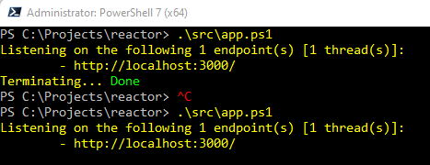
PS C:\> $Demo

Slide 12
Thank You!!!

